Slide 1
T-Mobile one
One plan One number One Carrier
T-Mobile

Slide 2
The problem
When I switched to T-mobile, I had to go and get a new simcard
The employee was very busy on the phone answering a customer’s stocking questions
It took me 45 minutes to do a 5 minute process because of this phone call

Slide 3
The solution
We created a chat bot that is capable of answering all of the customer’s questions based off their location
This solution allows store employees to maintain focus on in-store customers rather than answering phone calls when unnecessary

Slide 4
The backend
Customer calls T-Mobile
T-Mobile one answers
Twilio gets data on customer
Forwarded to Dialogue Flow
Everything gets passed to Azure processing
If it’s unfamiliar with customer’s term, it calls nearest store

Slide 5
The Data
We went to T-mobile stores around Atlanta asking them some basic data about their call data.
The stores we went to said:
5-30 people call daily
They usually call about Inventory, Bill Payment, and deals in store
The calls last from 5 seconds to ~10 minutes depending on the requests asked

Slide 6
The Data
We also called 45 stores around the country
We asked:
Do you have the 32 GB Jet Black iPhone 7+ in stock? What is the cost per month if I have pretty good credit (650)?
Where is your store located?
What time do you guys close tomorrow?

Slide 7
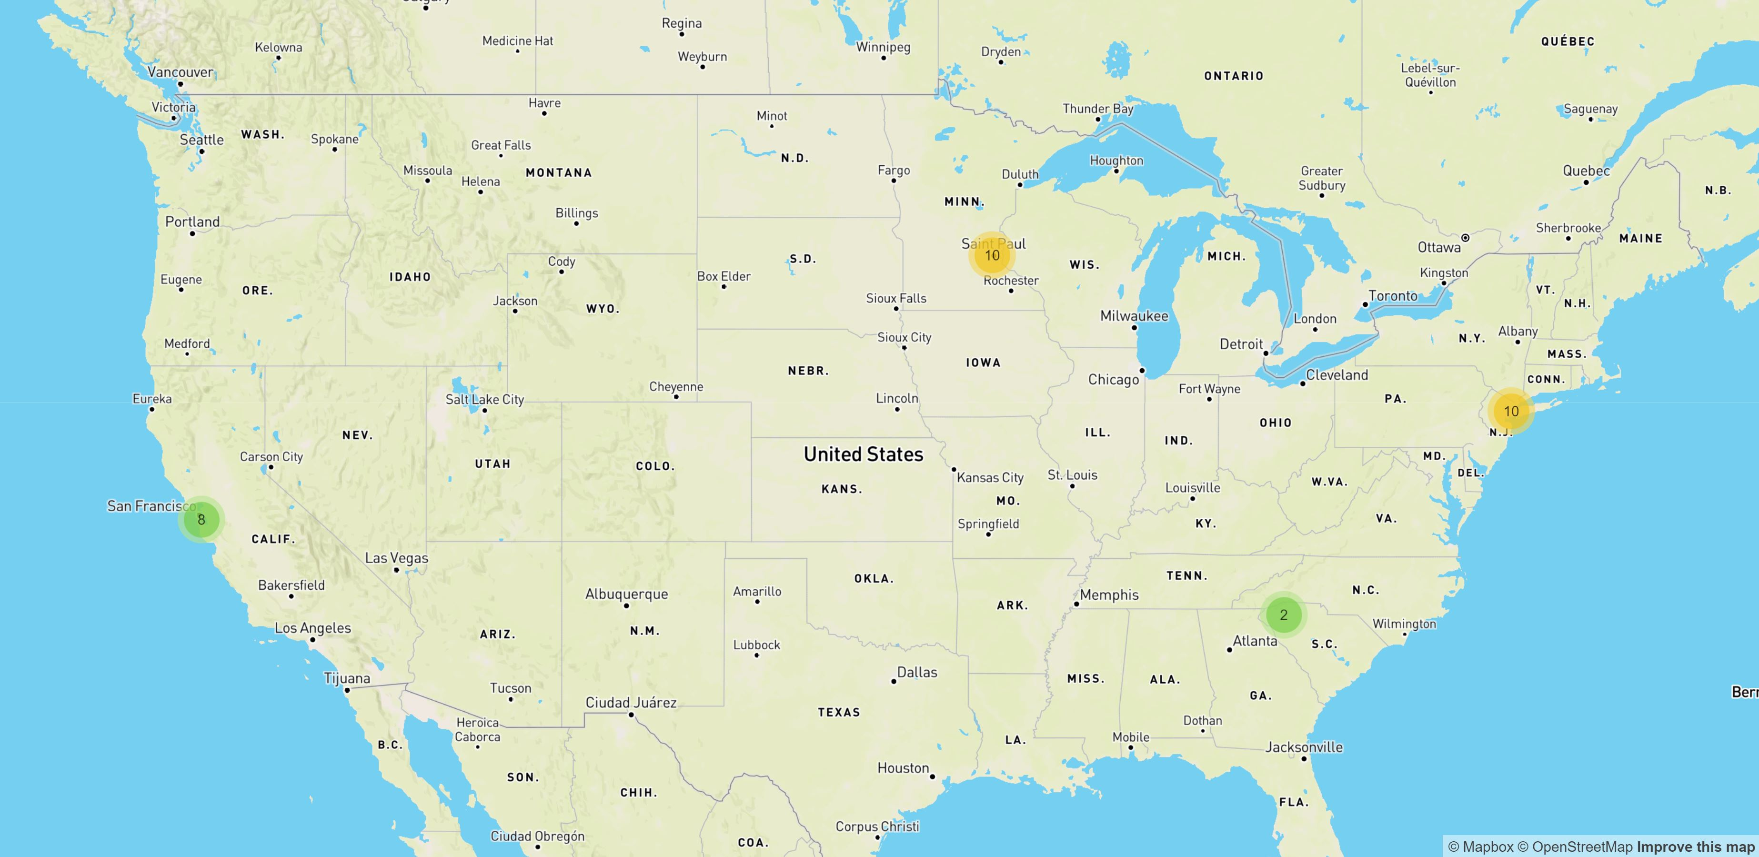
Just some stores

